Slide 1
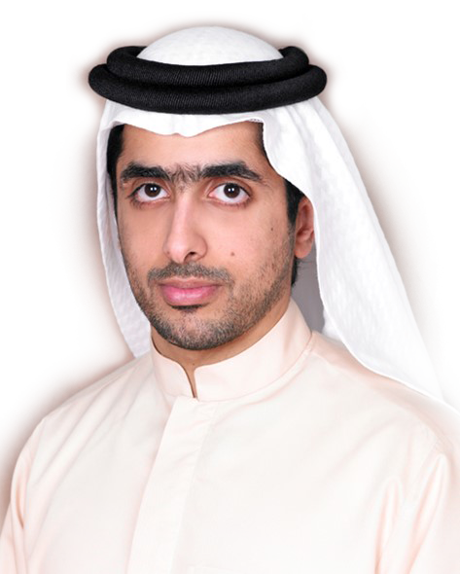
PART OF
MBM GROUP OF COMPANIES
“Our Vision is to establish MBM Logistics as a Dubai based leader in Global Logistics”
--
His Excellency
Sheikh Mohammed Bin Maktoum Bin Juma Al Maktoum

Slide 2
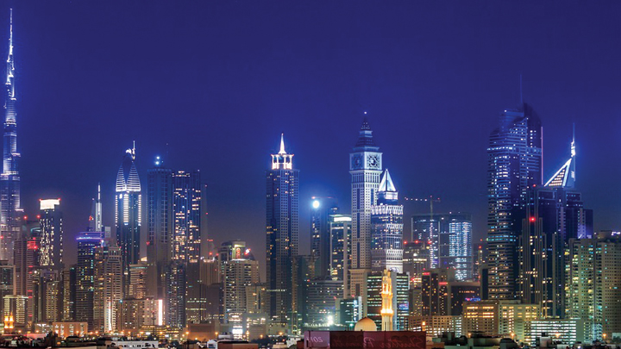
DUBAI – UAE A GLOBAL TRADE HUB
The last 20 years, Dubai has seen unprecedented growth, thanks to the developments in
infrastructure & logistical capabilities Jebel Ali, Dubai World Central (DWC) & Dubai Airport Free Zone (DAFZA) are way ahead in terms of capabilities & capacity.
The fast paced development of Dubai is an indication of its future promise, as a result global businesses are cashing on the Dubai’s value as a major inter-modal transshipment HUB.

Slide 3
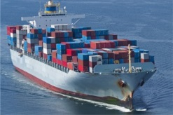
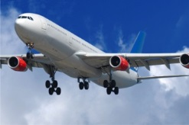
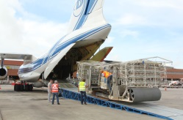
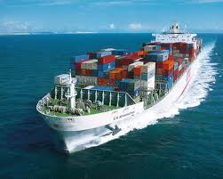
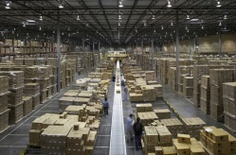
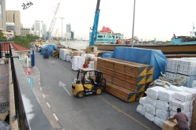
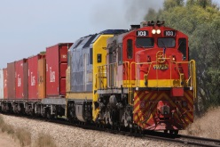
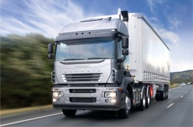
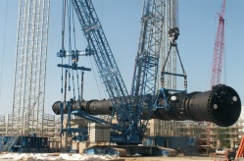
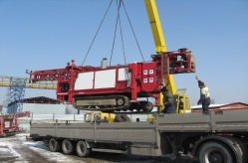
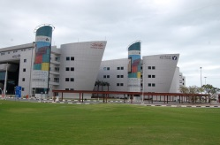
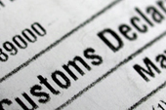
WORLD CLASS LOGISTICS SUPPORT
AIR &
SEA FREIGHT
CHARTERING
WAREHOUSING & DISTRIBUTION
LAND TRANSPORT
HEAVY LIFT & PROJECT CARGO
CUSTOM FORMALITIES

Slide 4
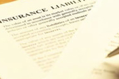
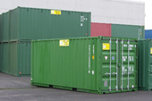
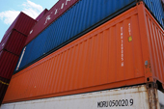
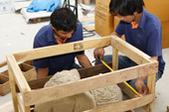
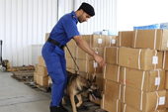
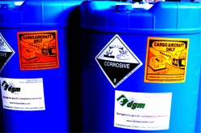
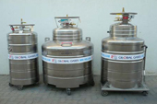
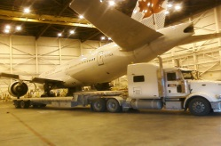
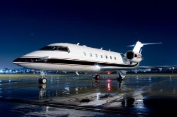
WORLD CLASS LOGISTICS SUPPORT
CARGO INSURANCE
PROCUREMENT OF SOC
PACKING & CRATING
CARGO SURVEY & INSPECTION
DANGEROUS
GOODS HANDLING
AOG SHIPMENTS

Slide 5

OVERSEAS FREIGHT FORWARDERS
NETWORK OF AGENTS IN 90 COUNTRIES
SERVICE OVER 200 AIR & SEA PORTS

Slide 6
STRENGTHS
MBM IS A BIG
BRAND ON IT’S OWN
GOOD RELATIONSHIP WITH MAJOR AIRLINES & SHIPPING LINES
STRONG NETWORK OF OVERSEAS PARTNERS
KNOWLEDGE OF LOCAL AND INTERNATIONAL LOGISTICS PRACTICES
EXPERIENCED LOGISTICS PROFESSIONALS

Slide 7
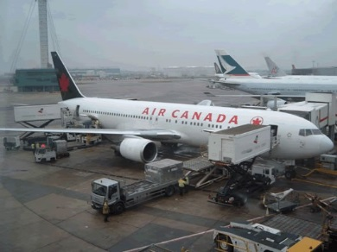
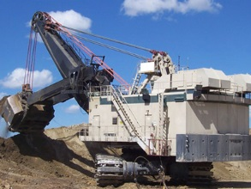
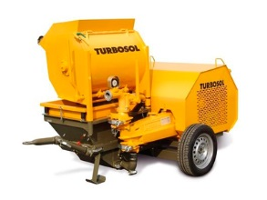
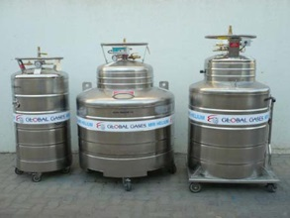

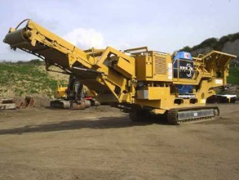
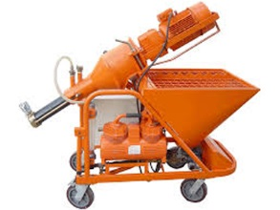
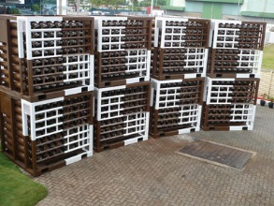
COMMODITIES & PRODUCTS HANDLED
AIRLINE ENGINES, PARTS &
GROUND HANDLING EQUIPMENTS
MINING
EQUIPMENTS
CONSTRUCTION
EQUIPMENTS
INDUSTRIAL
GASES

Slide 8


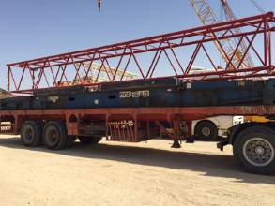
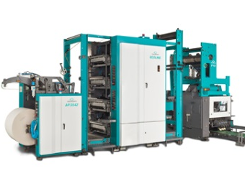

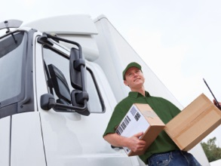
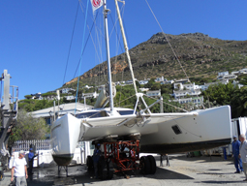
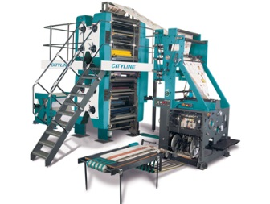
COMMODITIES & PRODUCTS HANDLED
HIGH VALUE FOOD PRODUCTS
IT & NETWORKING PRODUCTS
CRANES & BOATS
PRINTING INDUSTRY

Slide 9
DUBAI, TRANSSHIPMENT HUB
MBM facilitates transshipments of cargo to Upper Gulf, Iraq (Erbil, Umm Qasr), CIS nations & Africa
Sea Air & Air to Air transshipments from Far East to Europe & America

Slide 10
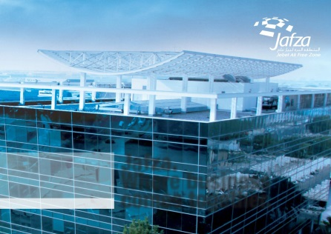
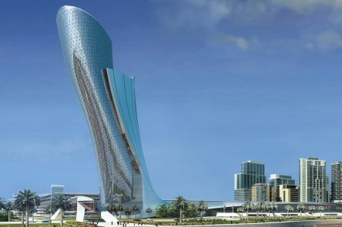

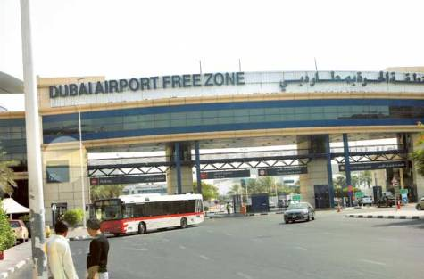
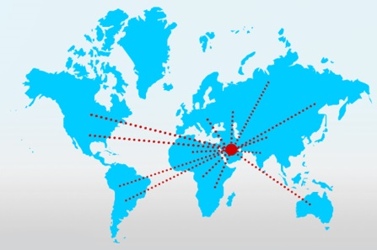
VISION 2020
CONTRIBUTE SERVICES TO
EXPO 2020
ESTABLISH WAREHOUSES IN DAFZA & JAFZA
ESTABLISH OFFICES IN ABU DHABI & GCC
ESTABLISH MBM
AS A REGIONAL PLAYER WITH GLOBAL CAPACITY

Slide 11
FUTURE VISION
MBM
TO BE KNOWN AS DUBAI’S OWN INTERNATIONAL LOGISTICS PROVIDER, WITH OFFICES & WAREHOUSES IN EMIRATES & GCC COUNTRIES
Kuwait
Bahrain
Qatar
Kingdom of
Saudi Arabia
United Arab
Emirates
Oman

Slide 12
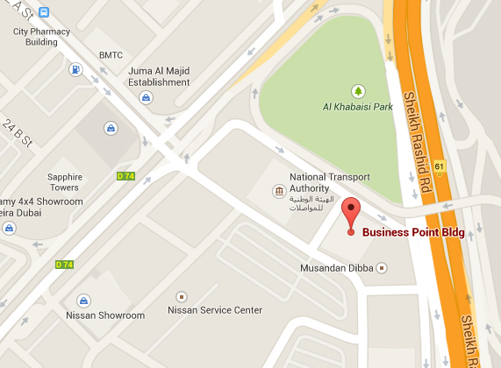
REACH US
MBM LOGISTICS LLC
LOCATION
Office No. 706, Business Point Building, Deira, Dubai, UAE
ADDRESS
P.O.Box: 127827
CALL
+971 4 294 0805
EMAIL
haridas@mbmlogisticsintl.com murali@mbmlogisticsintl.com
www.mbmlogisticsintl.com

Slide 13
THANK YOU

